Slide 1

MODULE 1
By
Ms.NOVY JACOB,
Assistant Professor,
AIML

Slide 2

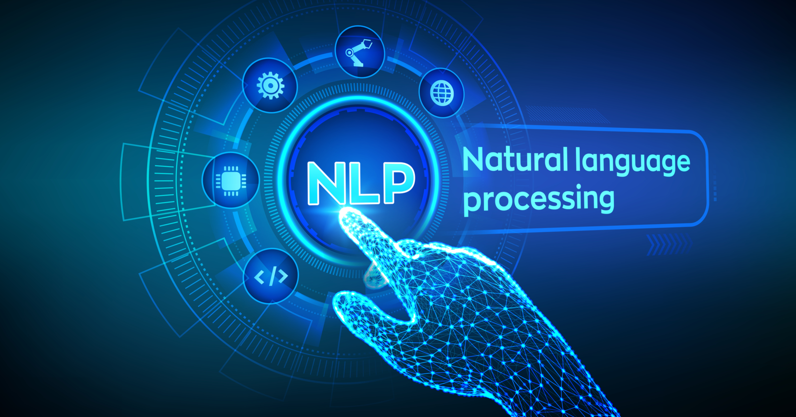
WHAT IS NLP
Language is the Primary means of communication used by human beings.
It is the tool used to express our ideas and emotions.
It shapes thoughts, has a structure and carries meaning.
Learning new concepts and expressing ideas through a language is so natural to human beings that we hardly realize how we process natural language.
We never learn a computational model of language. But, If we want to automate processing of language, the very first step is to build a computational model.

Slide 3
WHAT IS NLP
Natural Language Processing is concerned with development of computational models of aspects of human language processing.
The two main reasons for this development are:
  To develop automated tool for language processing.
  To gain a better understanding of human communication.
  eg: google analyst, Alexa,Siri.
To build computational models with human language-processing abilities requires a knowledge of how human acquire, store, and process language.
It also requires a knowledge of the world and of language.

Slide 4
challenges
Data Complexity.
phrasing ambiguity.
Identify the semantics
complexity of words
quantifier scoping
Language references
words with multiple meanings.
sentences with ambiguous meaning.

Slide 5
APPROACHES
The two major approaches to NLP -
Rationalist Approach
Empiricist Approach
1. Rationalist Approach:
Early NLP research is based on rationalist approach, which assumes the existence of some language faculty in human brain.
Supporters argued that it is not possible for children to learn a complex thing like natural language from limited sensory input.
2. Empiricist:
Empiricists do not believe in existence of language faculty.
They believe in the existence of some general organization principles such as pattern recognition, generalization and association.
Learning of detailed structures is therefore possible through the application of these principles on sensory inputs available to the child.

Slide 6
ORIGINS OF NLP
Natural Language Processing sometimes mistakenly termed Natural Language understanding, originated from machine translation research.
Natural language understanding involves only the interpretation of language.
Natural Language Processing includes both understanding (interpretation) and generation (production). NLP also includes speech processing.
(NLP Syllabus is concerned with only text processing covering work in the area of computational linguistics.)
Linguistics is a term that refers to the study of language, its structure, grammar, syntax and phonetics.

Slide 7
ORIGINS OF NLP
Computational linguistics is similar to theoretical and psycho-linguistics but uses different tools.
Theoretical Linguistics:
provides structural description of natural language and its semantics.
It is not concerned with the actual processing of sentences or generation of sentences from structural description.
It defines principles that remain common across languages and identify rules that capture linguistic generalization.
For example, most languages have constructs like noun and verb phrases.
It identifies rules that describe and restrict the structure of languages (grammar).

Slide 8
ORIGINS OF NLP
Psycho-linguistics:
deals with how humans produce and comprehend natural language
It is mainly concerned with representation of linguistic structures and the process by which the structures are produced.
Computational Linguistics:
is concerned with the study of language using computational models of linguistic phenomena.
It deals with application of linguistics theories and computational techniques for Natural Language Processing.

Slide 9
ORIGINS OF NLP
Computational models can be broadly classified as
Knowledge Driven
Data Driven
Knowledge Driven:
  Knowledge driven systems rely on explicitly coded linguistic knowledge, often expressed as a set of handcrafted grammar rules.
Drawback
    Acquiring and Encoding knowledge is difficult.
    It is constrained by lack of sufficient coverage of domain knowledge.
2. Data Driven:
  Presume the existence of large amount of data and use machine learning tools to learn syntactic patterns.
  Human effort is less but performance of these systems is dependent on the amount of data.

Slide 10
LANGUAGE AND KNOWLEDGE
Relation between language and knowledge:
Language is the medium of expression in which knowledge is deciphered.
We are considering the text as the language and the content of it as knowledge.
Language is the outer form of the content it expresses.
The same content can be expressed in different languages.
To process a language is to process the content of it.
As computers are not able to understand natural language, methods are developed to map its content in a formal language.
Notes:
decipher - means to make out, to translate, to figure out

Slide 11
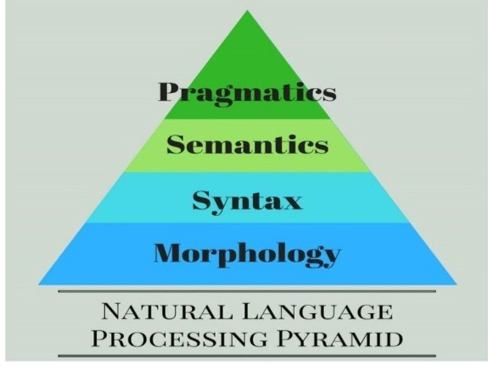
LANGUAGE AND KNOWLEDGE
Language Processing:
Language or text processing has different levels and each level involves different types of knowledge.
Various levels of processing text and the types of knowledge it involves -
Sl. No. | Text Processing | Knowledge
1 | Lexical Analysis | Morphological knowledge
2 | Syntactic Analysis | Syntactic knowledge
3 | Semantic Analysis | Pragmatic knowledge
4 | Discourse Analysis | Discourse knowledge
Notes:
decipher - means to make out, to translate, to figure out

Slide 12
LANGUAGE AND KNOWLEDGE
Lexical Analysis:
The simplest level of analysis is lexical analysis which involves analysis of words. (Lexical - relating to the words or vocabulary of a language)
Words are the most fundamental unit of any natural language text.
Word-level processing requires morphological knowledge.
Morphological knowledge - knowledge about the structure and formation of words from basic units called morphemes.
The rules for forming words from morphemes are language specific.

Slide 13
LANGUAGE AND KNOWLEDGE
Morphological Analysis:
Morphological analysis is a field of linguistics that studies the structure of words.
It identifies how a word is produced through the use of morphemes.
Morphemes are the smallest meaningful words which cannot be divided further. It is the smallest element of a word that has grammatical function and meaning.
Free morpheme and bound morpheme are the two types of morphemes.
A single free morpheme can become a complete word. For instance, a bus, a bicycle, and so forth.
A bound morpheme, on the other hand, cannot stand alone and must be joined to a free morpheme to produce a word. ing, un, and other bound morphemes are examples.
Unsuccessfull → un success ful
(prefix) (stem) (suffix)

Slide 14
LANGUAGE AND KNOWLEDGE
2. Syntactic Analysis:
Syntactic analysis considers a sequence of words as a unit, usually a sentence and finds its structure.
Syntactic analysis decomposes a sentence by looking into its constituents (or words) and identifies how they relate to each other.
It captures grammaticality or non-grammaticality of sentences by looking at constraints like word order, number, and case agreement.
This level of processing requires syntactic knowledge.
Syntactic Knowledge:
Syntactic knowledge is knowledge about how words are combined to form larger units such as phrases and sentences and what constraints are imposed on them.
Not every sequence of words results in a sentence - For example, ‘I went to the market’ is a valid sentence whereas ‘went the I market to’ is not
This level of analysis requires detailed knowledge about the rules of grammar.

Slide 15
LANGUAGE AND KNOWLEDGE
3. Semantic Analysis:
Semantic analysis is associated with the meaning of the language.
It is concerned with creating meaningful representation of linguistic inputs.
Defining meaning components is difficult as grammatically valid sentences can be meaningless.
Humans apply all sorts of knowledge - lexical, syntactic, semantic, discourse, pragmatic, and world knowledge to arrive at the meaning of a sentence.
The starting point in semantic analysis is lexical semantics (meaning of words).
A word can have any number of possible meanings associated with it. But in a given context, only one of those meanings will be applied.
The meaning of a sentence cannot be composed solely on the basis of meaning of its words.

Slide 16
LANGUAGE AND KNOWLEDGE
Consider the following sentences:
  Kabir and Ayan are married.
  Kabir and Suha are married.
Both sentences have identical structures, and the meaning of individual words are clear. But most of us end up with two different interpretations.
We may interpret the second sentence to mean that Kabir and Suha are married to each other, but this interpretation does not occur from the first sentence.
Syntactic structure and compositional semantics fail to explain these interpretations.
Here we make use of pragmatic information.
Hence semantic analysis requires pragmatic knowledge besides semantic and syntactic knowledge.
Pragmatic analysis deals with outside word knowledge, which means knowledge that is external to the documents and/or queries.

Slide 17
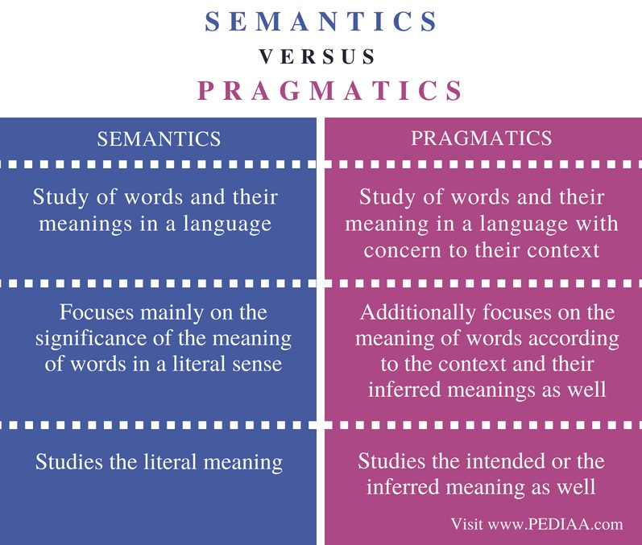
LANGUAGE AND KNOWLEDGE

Slide 18
LANGUAGE AND KNOWLEDGE
4. Discourse Analysis:
Discourse-level processing attempts to interpret the structure and meaning of even larger units, e.g., at the paragraph and document level, in terms of words, phrases, clusters and sentences.
It requires the resolution of anaphoric references and identification of discourse structure.
It requires discourse knowledge - knowledge of how the meaning of a sentence is determined by preceding sentences.
  example, how a pronoun refers to the preceding noun and how to determine the function of a sentence in the text.

Slide 19
LANGUAGE AND KNOWLEDGE
4. Discourse Analysis:
Pragmatic knowledge may be needed for resolving the anaphoric references.
In the following sentences, pragmatic knowledge is required to resolve the anaphoric reference - ‘they’.
The district administration refused to give the trade union
permission for the meeting because they feared violence.
The district administration refused to give the trade union
permission for the meeting because they oppose government.
The highest level of processing is pragmatic analysis, which deals with the purposeful use of sentences in situations.
It requires knowledge of the world i.e., knowledge that extends beyond the content of the text.

Slide 20
CHALLENGES OF NLP
There are a number of factors that make NLP difficult -
Problems of representation and interpretation
  Language computing requires precise representation of content.
  As natural languages are highly ambiguous and vague, achieving such representation is difficult.
The inability to capture all the required knowledge is another source of difficulty
  It is almost impossible to embody all sources of knowledge that humans use to process language.
  Even if it is done, it is not possible to write procedures that imitate language processing as done by humans.
Greatest source of difficulty in natural language is identifying its semantics
  The principle of compositional semantics considers the meaning of a sentence to be a composition of the meaning of the words appearing in it.
  Words alone do not make a sentence. It is the words as well as their syntactic and semantic relation that give meaning to sentence.

Slide 21
CHALLENGES OF NLP
A language keeps on evolving. New words are added continuously and existing words are introduced in new context.
Example 9/11 - refers to the terrorist attack on WTC in USA in 2004. When we process such written text, we have access to underlying mental representation.
The only way a machine can learn the meaning of a specific word in a message is by considering its context, unless some explicitly coded general world or domain knowledge is available.
The context of a word is defined by co-occurring words. It includes everything that occurs before or after a word.
Idioms, metaphor and ellipses add more complexity to identify the meaning of the written text
  Ex.: The old man finally kicked the bucket.
  The meaning of this sentence has nothing to do with words ‘kick’ and ‘bucket’ appearing in it.

Slide 22
CHALLENGES OF NLP
Quantifier scoping:
  The scope of quantifiers (the, each, etc.) is not clear and poses problem in automatic processing.
  A quantifier is a word that usually goes before a noun to express the quantity of the object; for example, a little milk.
Ambiguity:
  Ambiguity, often goes unnoticed, yet are correctly interpreted because we use explicit and as well as implicit sources of knowledge.
  Communication via language involves two brains, the brain of the speaker/writer and that of the hearer/reader.
  Anything that is assumed to be known to the receiver is not explicitly encoded.
  The receiver possesses the necessary knowledge and fills in the gaps while making an interpretation.
  As humans, we are aware of the context and current cultural knowledge and also of the language and traditions and use these to process the meaning.
  But, incorporating contextual and world knowledge poses the greatest difficulty in language computing.
  Ex: To an Indian, the word ‘Taj’ mean a monument, a brand of tea, or a hotel, which may not be so for a non-Indian

Slide 23
CHALLENGES OF NLP
  Various sources of ambiguities in natural languages:
    First level of ambiguity is at the word level.
      There are words that have multiple meaning associated with them.
      Ex: bank, can, bat and still
      A word may be ambiguous in its part-of-speech or it may be ambiguous in its meaning
      The word ‘can’ is ambiguous in its part-of-speech, but the word ‘bat’ is ambiguous in its meaning.
      The program must be explicitly coded to resolve each meaning. We need to develop various models and algorithms to resolve them.
      Deciding whether ‘can’ is a noun or a verb is solved by ‘part-of-speech-tagging’.
      Identifying whether a particular use of ‘bank’ corresponds to ‘financial institution’ sense or ‘river bank’ sense is solved by ‘word sense disambiguation’.

Slide 24
CHALLENGES OF NLP
    second level of ambiguity is at sentence level
      A sentence may be ambiguous even if the words are not.
      Ex: ‘Stolen rifle found by tree’
      None of the words in this sentence is ambiguous but the sentence is.
      This is an example of structural ambiguity.
      Verb subcategorization will help resolve this type of ambiguity but not always.
      Probabilistic parsing is another solution.
Higher level ambiguities are pragmatic and discourse ambiguities.
Number of Grammars:
A number of grammars have been proposed to describe the structure of sentences.
There are infinite number of ways to generate grammar, which makes the grammar rules, and grammar itself, extremely complex.
We make correct semantic interpretations of non-grammatical sentences.
This makes it impossible for grammar to capture the structure of all and only meaningful text.

Slide 25
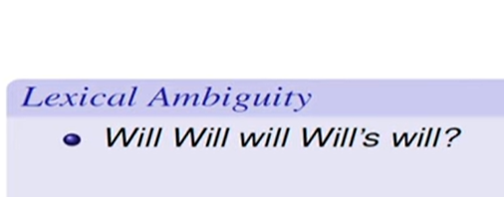
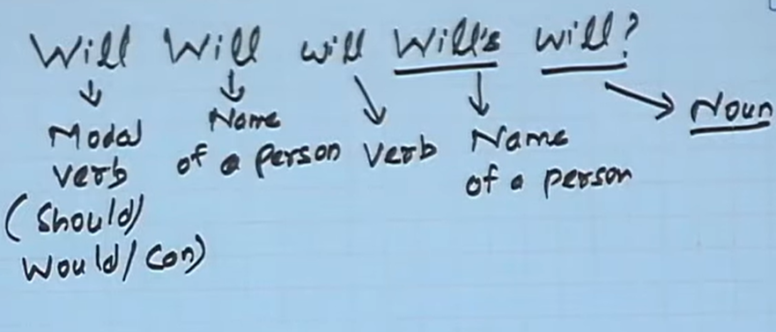

Slide 26

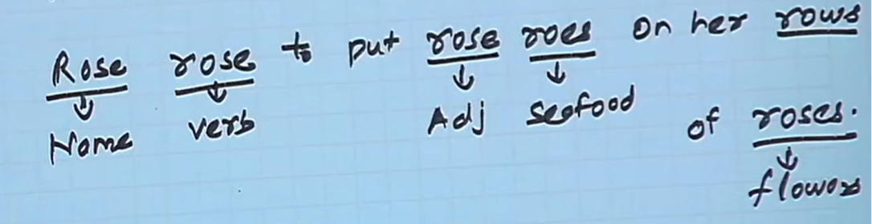

Slide 27
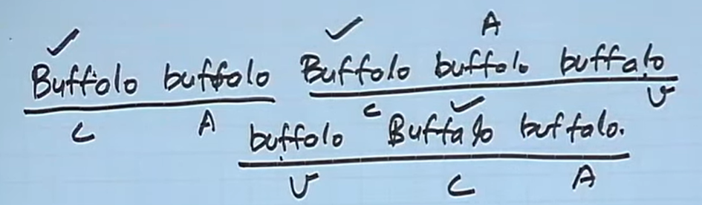

Slide 28
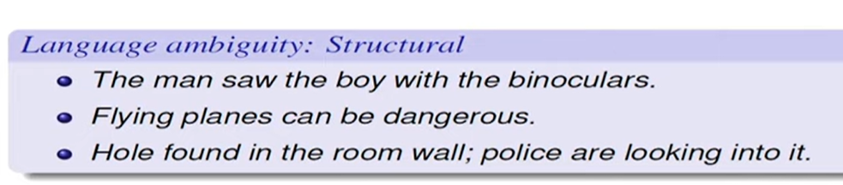
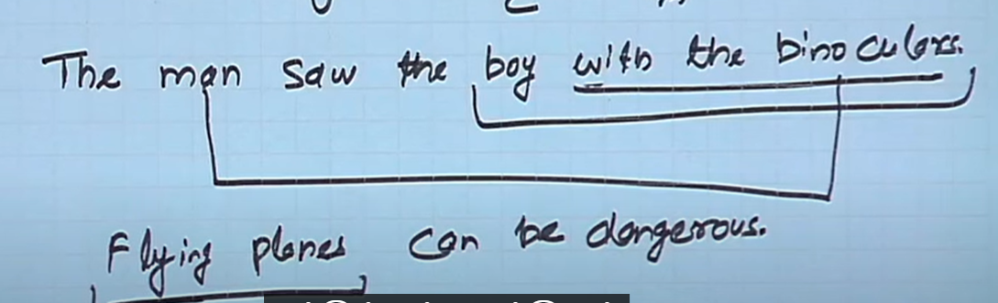

Slide 29
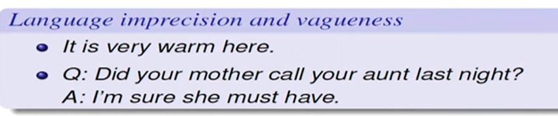
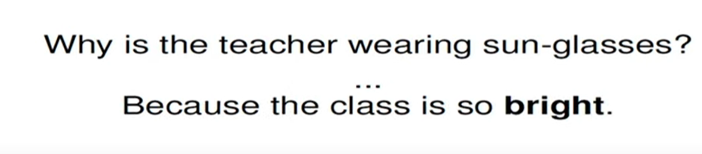

Slide 30
LANGUAGE AND GRAMMAR
Automatic processing of language requires the rules and expectations of a language to be explained to the computer.
Grammar defines the language.
  It consists of set of rules that allows us to parse and generate sentences in a language.
  Thus, it provides the means to specify natural language.
  These rules relate information to coding devices at the language level, but not at the world knowledge level.
Main hurdle in language specification comes from
  the constantly changing nature of natural languages and
  the presence of large number of hard-to-specify exceptions.

Slide 31
LANGUAGE AND GRAMMAR
Several efforts have been made to provide language specifications which has led to the development of a number of grammars as follows -
Transformational Grammar introduced by Chomsky in 1957.
Lexical Functional Grammar developed by Kaplan and Bresnan in 1982. (focus is on relationships).
Government and Binding by Chomsky in 1981.
Generalized Phrase Structure Grammar. (focus is on derivation).
Dependency Grammar (focus is on relationships).
Paninian Grammar (focus is on relationships).
Tree adjoining Grammar introduced by Joshi in 1985.

Slide 32
LANGUAGE AND GRAMMAR
Noam Chomsky Grammar:
  The greatest contribution to grammar comes from Noam Chomsky.
  He proposed a hierarchy of formal grammar based on the level of complexity.
  These grammars use phrase structure rules or rewrite rules.
Generative grammar:
  The term generative grammar refers to the general framework introduced by Chomsky.
  It basically refers to any grammar that uses a set of rules to specify or generate all and only grammatical sentences in a language.
According to Chompski phrase structure grammars are not adequate to specify natural language. So Chomsky proposed complex system of transformational grammar, according to which each sentence in a language has two levels of representation.
1. Deep Structure (DS)
2. Surface Structure (SS)
Mapping from DS to SS is carried out by Transformations.

Slide 33
TRANSFORMATIONAL GRAMMAR
Transformational grammar was introduced by Chomsky in 1957.
According to him, an utterance is the surface representation of a ‘deeper structure’ representing its meaning.
The deep structure can be transformed in number of ways to yield many different surface level representation.
Sentence with different surface level representations having the same meaning, share a common deep level representation.

Slide 34
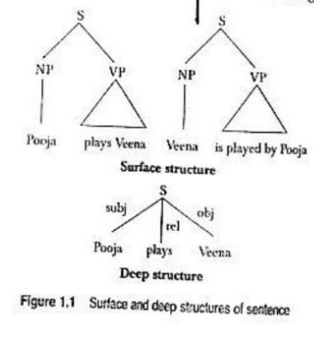
TRANSFORMATIONAL GRAMMAR
Ex: Pooja plays Veena
Veena is played by Pooja.
Both the sentences have the same meaning but different surface structures. Roles of subject and object are inverted.
Both the sentences are generated from the same ‘deep structure’ in which the ‘deep subject’ is Pooja and ‘deep object’ is the veena.

Slide 35
TRANSFORMATIONAL GRAMMAR
Transformational Grammar has 3 Components
Phrase Structure Grammar
Transformational Rules
Morphophonemic rules
All three components consists of a set of rules.

Slide 36
TRANSFORMATIONAL GRAMMAR
Phrase structure grammar:
Phrase structure grammar consists of rules that generate natural language sentences and assign a structural description to them.
Following are the set of rules:
S - sentence
VP - verb phrase
NP - noun phrase
V - verb
Det - determiner
Aux - Auxiliary verb
S 🡪 NP + VP
VP 🡪 V + NP
NP 🡪 Det + Noun
V 🡪 Aux + Verb
Det -> the, a, an, …
Verb -> catch, write, eat, …
Noun -> police, snatcher, …
Aux -> will, is, can, …

Slide 37
PRACTICE
Sentence: I ate apple
Transformational Grammar for the sentence - I ate apple
S -> Np+VP
NP -> I
VP -> V+NP
V -> ate
NP -> apple

Slide 38
PRACTICE
Sentence: Pooja Plays Veena
Transformational grammar for the sentence - Pooja plays veena
S -> NP+VP
Np -> pooja
VP -> V+Np
V -> plays
NP -> veena

Slide 39
PRACTICE
Sentence: A boy hit the girl
Transformational Grammar for the sentence - A boy hit the girl
S -> NP + VP
NP -> Det + Noun
VP -> V + NP
V -> Aux + V
Det -> A, the
Noun -> boy, girl
Verb -> hit

Slide 40
PRACTICE
Sentence: The Police will catch the snatcher
Transformational Grammar for the sentence - The Police will catch the snatcher
S -> NP+VP
NP -> Det+Noun
VP -> V+NP
V -> Aux+V
Det -> the
Noun -> police, snatcher
Verb -> catch
Aux -> will

Slide 41
TRANSFORMATIONAL GRAMMAR
2. Transformational rules:
The second component of transformational grammar is a set of transformational rules, which transform one phrase-maker into another phrase maker.
These rules are applied on the terminal string generated by phrase structure rules.
Unlike phrase structure rules, transformational rules are heterogeneous and may have more than one symbol on their left hand side.
These rules are used to transform one surface representation into another, for example, an active sentence into passive sentence
The rule relating to active and passive sentences is -
NP1- Aux – V - NP2 🡪 NP2 – Aux + be + en – V – by - NP1
Transformational Rules can be obligatory or optional.
An obligatory transformation is one that which ensures agreement in number of subject and verb.
An optional transformation is one that modifies the structure of a sentence while preserving its meaning.
Morphophonemic rules match each sentence representation to a string of phonemes

Slide 42
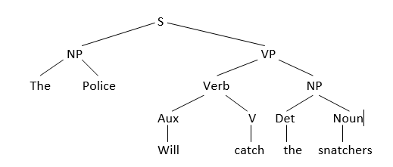
TRANSFORMATIONAL GRAMMAR
Example for transformational rules:
Consider the active sentence - The police will catch the snatcher.
The application of phrase structure rules will assign the structure as shown below
Parse structure of the sentence - ‘The police will catch the snatcher’

Slide 43
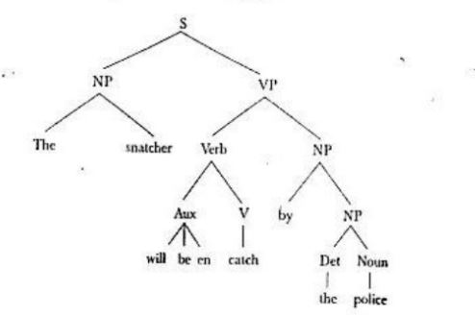
TRANSFORMATIONAL GRAMMAR
The passive transformation rules will convert the sentence into:
The + snatcher + will + be + en + catch + by + the + police

Slide 44
TRANSFORMATIONAL GRAMMAR
The Police will catch the snatcher. NP1-Aux-V-NP2
The snatcher will be caught by the police NP2-Aux-be+en-V+by+NP1
The rule relating to conversion of active to passive sentence -
NP1- Aux – V - NP2 🡪 NP2 – Aux + be + en – V – by - NP1

Slide 45
TRANSFORMATIONAL GRAMMAR
3. Morphophonemic rules:
Transformational rule will reorder ‘en + catch’ to ‘catch + en’ and subsequently one of the morphophonemic rules will convert ‘catch + en’ to ‘caught’.
‘en + catch’ ---> ’Catch + en’ ---> Caught

Slide 46
PROCESSING INDIAN LANGUAGE
There are a number of differences between Indian language and English as a result there exists differences in their processing. The following are the differences -
Unlike English, Indian Scripts have a non linear structure.
Unlike English, Indian languages have Subject Object Verb (SOV) as a default sentence structure.
Indian languages have a free word order i.e, words can be moved freely within a sentence without changing the meaning of the sentence.
Spelling Standardization is more subtle in Hindi than in English. That is, it is delicate in meaning or intent and difficult to understand.
Indian Languages have a rich set of morphological variants.
Indian Languages makes extensive and productive use of complex predicates (CPs).
Indian Languages uses post-position (Karakas) case markers instead of preposition.
Indian Languages uses verb complexes consisting of sequences of verbs.
Ex1: गा रहा है -> Singing
Ex2: खेल रही है -> Playing
The auxiliary verbs in these examples provide information about tense, aspect, modality etc.
Paninian grammar provides a framework for Indian language models
Notes:
delicate in meaning or intent; difficult to perceive or understand

Slide 47
NLP APPLICATIONS
Applications of NLP:
Machine Translation:
  refers to automatic translation of text from one human language to another.
  For machine translation it is necessary to have understanding of words and phrases, grammars of two languages involved, semantics of the language and world knowledge.
Speech Recognition:
  Speech recognition is the process of mapping acoustic speech signals to a set of words.
  The difficulties arise due to wide variations in the pronunciation of words, homonym (Ex: dear and deer) and acoustic ambiguities in the sense of hearing (Ex: interest and in the rest).
Speech Synthesis:
  Speech synthesis refers to automatic production of speech (utterance of natural language sentences).
  Systems can read out mails on telephone or even read out a story book.
  NLP is an important component of speech synthesis system because in order to generate utterances text has to be processed.

Slide 48
NLP APPLICATIONS
Natural Language interfaces to databases:
  This allows querying a structured database using natural language sentence.
Information Retrieval:
  Information retrieval is concerned with identifying documents relevant to a users query.
  Indexing (stop word elimination, stemming, phrase extraction, etc.), word sense disambiguation, query modification and knowledge bases are used in IR system to enhance performance.
  WordNet, LDOCE (Longman Dictionary of Contemporary English) and Roget’s Thesaurus are few lexical resources for IR research.
Information Extraction:
  Information extraction system captures and outputs factual information contained within a document.

Slide 49
NLP APPLICATIONS
Question Answering:
  Given a question and a set of documents, a question answering system attempts to find the precise answer.
  It requires more NLP than IR system or an information extraction system
Text Summarization:
  It deals with creation of summaries of documents and involves syntactic, semantic discourse level processing of text.

Slide 50
Difference between IR and IE
Sl. No. | IR system | IE system
1 | Responds to user’s information need and the information need is expressed as a keyword query | Responds to user’s information need and the information need is specified as predefined database schemas or templates.
2 | Task of finding text documents which are relevant to a user’s information need | Goal is to extract prespecified features from documents
3 | Document retrieval | Feature retrieval
4 | Actual information buried inside the document | Extract information from within the document

Slide 51
EARLY NLP SYSTEMS
ELIZA (Weizenbaum 1966)
  One of the earliest natural language understanding programs.
  Uses syntactic patterns to mimic human conversation with the user.
SysTran (System Translation)
  Developed in 1969 for Russian-English translation.
  Provided the first online machine translation service called Babel Fish which is used by Alta Vista search engines for handling translation requests from users
TAUM METEO
  a natural language generation system used in Canada to generate weather reports.
  Accepts daily weather data and generates weather reports in English and French.
SHRDLU (Winogard 1972)
  a natural language understanding system that simulates actions of a robot in a block world domain.
  uses syntactic parsing and semantic reasoning to understand instructions.
LUNAR (Woods 1977)
  a early question answering system that answered questions about moon rock.

Slide 52
INFORMATION RETRIEVAL
IR systems aim at providing a solution to get relevant information from large amount of text which is available in electronic form.
Information - reflects ‘subject matter’ or the ‘content’ of some text. Its is concerned with text only.
Retrieval - refers to operation of accessing information from text
  it requires information to be processed and stored
  Not all information is retrieved, only the information relevant to the needs expressed in the form of query is located.
  to ensure the relevance, the stored and processed information will be compared against query.
Hence, IR is concerned with the organization, storage, retrieval and evaluation of information relevant to the query.
IR deals with unstructured data. Retrieval is performed based on the content of the document rather than on its structure.
IR system returns a ranked list of documents.
Two approaches for accessing large text collections -
  constructs topic hierarchy, eg. Yahoo
    helps the user locate documents of interest manually by traversing the hierarchy
    its cost ineffective and inapplicable due to rapid growth of documents on WEB
  ranks the retrieved documents according to relevance.

Slide 53
INFORMATION RETRIEVAL
Major issues in Information Retrieval:
To choose a representation of the document
  Most Human knowledge is coded in natural language, which is difficult to use as knowledge representation language for computer systems.
Keyword based retrieval:
  ignores semantic and contextual information in the retrieval process.
  creates problem during retrieval due to polysemy, homonymy and synonymy
  polysemy - lexeme with multiple meaning, eg.: the verb ‘to get’ means
    ‘procure’ (I’ll get the drinks)
    ‘become’ (she got scared)
    ‘understand’ (I get it)
  homonymy - words that are spelled and pronounced the same but have unrelated meanings, eg. bat, bank, read etc.
    Ambiguity makes it difficult to for a computer to automatically determine the conceptual content of documents.
  synonymy - two different words with similar meanings. eg. start, begin, initiate, commence.
    Synonymy creates problem when a document is indexed with one term and the query contains a different term, and the two terms share a common meaning.
Notes:
A polyseme - a word or phrase with different, but related senses. ... English has many polysemous words. For example, the verb "to get" can mean "procure" (I'll get the drinks), "become" (she got scared), "understand" (I get it) etc.
lexeme - a language's most basic unit of meaning, often also thought of as a word in its most basic form. Not all lexemes consist of just one word, though, as a combination of words are necessary to convey the intended meaning. Examples of lexemes include walk, fire station, and change of heart, bus stop.
The word Homonymy (from the Greek—homos: same, onoma: name) is the relation between words with identical forms but different meaning. example: the word bank as it appears in "river bank" and "savings ​bank."

Slide 54
INFORMATION RETRIEVAL
Inappropriate characterization of queries by the user:
  There can be many reasons for vagueness and inaccuracy of the user’s queries eg.: lack of knowledge of the subject
  user may fail to include relevant terms in the query or may include irrelevant terms
  inaccurate queries lead to poor retrieval performance
  illspecified queries can be dealt with by modifying or expanding queries
Matching query representation with document:
  To satisfy user’s request, an IR system matches document representation with query representation.
  A number of measures have been proposed to quantify the similarity between a query and the document to produce a ranked list of results.
  selection of appropriate similarity measure is a crucial issue in the design of IR systems.
Choosing an appropriate metric to Evaluate the performance of IR systems:
  Among many aspects of evaluation, the most important among them is effectiveness of the system
  recall and precision are the most widely used measures of effectiveness.

Slide 55
INFORMATION RETRIEVAL
Relevance issue:
  major goal of IR is to search a document in a manner relevant to the query, understanding what constitutes relevance is an important issue.
  relevance is subjective in nature.
  only the user can tell the true relevance. It is not possible to measure true relevance.
  a number of relevance framework have been proposed which includes system, communication, psychological and situational frameworks.
  the most inclusive is the situational framework, which considers the importance of situation, context, multi-dimensionality and time
Size of document collections and the varying needs of users:
  some users require answers of limited scope
  some require documents with a wider scope
  these differing needs require different and specialized retrieval methods

Slide 56
CHAPTER 2
LANGUAGE MODELLING
Two approaches to understand and generate natural language from a computational viewpoint -
To take a language, understand every word and sentence of it and draw the conclusion. This approach has not succeeded as there are difficulties in each stage.
An alternative approach is to study the grammar of various languages, compare them and arrive at reasonable models.
Model:
A model is a description of some complex entity or process.
Language Modelling:
A language model is a description of language where the natural language is the complex entity.
To process a language model through a computer based program, we need to build a representation or model of the language. This is known as language modelling.

Slide 57
LANGUAGE MODELLING
Two approaches of Language Modelling:
Grammar based language model
  attempts to distinguish a grammatical sentence from a non-grammatical one.
2. Probabilistic or Statistical language model
  attempts to identify a sentence based on a probability measure.

Slide 58
Grammar based language model
A grammar based approach uses the grammar of a language to create its model.
It attempts to represent the syntactic structure of language.
Grammar consists of hand-coded rules defining the structure and ordering of various constituents appearing in a linguistic unit (phrase, sentence, etc.)
Example, a sentence usually consists of noun phrase and a verb phrase.
The grammar based approach attempts to utilize this structure and also the relationship between these structures.

Slide 59
Statistical language modelling
The statistical approach creates a language model by training it from a corpus.
corpus - A large collection of texts selected in a systematic way and stored as an electronic database.
Statistical language modelling is one of the fundamental tasks in many NLP applications - speech recognition, spelling correction, handwriting recognition, machine translation, information retrieval, text summarization and question answering.

Slide 60
VARIOUS GRAMMAR BASED LANGUAGE MODELS
Generative Grammar
Hierarchical Grammar
Government and Binding (GB)
Lexical Functional Grammar (LFG)
Paninian Grammar (PG)

Slide 61
Generative Grammar
According to Noam Chomsky “We can generate sentences in a language if we know a collection of words and rules in that language.”
Only those sentences that are generated as per the rules are grammatical.
This is termed as generative grammar and the same idea can be used to model a language.
If we have complete set of rules that can generate all possible sentences in a language, those rules provide a model of that language.

Slide 62
Hierarchical Grammar
Chomsky described classes of grammar in a hierarchical manner, where the top layer contained the grammars represented by its subclasses.
Type 0 (or unrestricted) grammar contains Type 1 (or context sensitive grammar) which in turn contains Type 2 (context free grammar) and that again contains Type 3 grammar (regular grammar)
It can be extended to describe grammars at various levels.
Type 0 Unrestricted
Type 1 Context Sensitive Grammar
Type 2 Context Free Grammar
Type 3 Regular Grammar

Slide 63
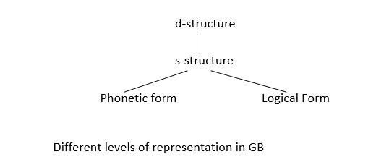
Government and Binding (GB)
Chomsky was the first to put forward GB theory.
Transformational grammars assume two levels of existence of sentences -
surface level
deep root level
Government and binding (GB) theory has four levels
s-level (surface level of transformational grammar is renamed as s-level)
d-level (deep root level of transformational grammar is renamed as d-level)
phonetic form
logical form
phonetic form and logical form are parallel to each other.

Slide 64
Government and Binding (GB)
Language is the representation of some ‘meaning’ in a ‘sound’ form.
‘meaning’ logical form (LF) and
‘sound’ phonetic form (PF)
GB is concerned with Logical Form rather than Phonetic Form.
Transformational grammars have hundreds of rewriting rules, which are language specific and construct specific - like different rules for assertive, interrogative, active and passive voice sentences.
Generation of a complete set of generic rules is not possible.
The vision of GB is, if we define rules for structural units at the deep level, it will be possible to generate any language with fewer rules.
These deep level structures are common to all languages.
The existence of deep level, language-independent, abstract structures, and the expression of these in surface level, language-specific structures with the help of simple rules is the main concern of GB theory.

Slide 65
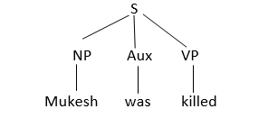
Government and Binding (GB)
Example to explain d- and s- structures
Sentence: Mukesh was killed
(i) In transformational grammar, this can be represented as
S - NP Aux VP
Transformational Grammar of sentence - Mukesh was killed

Slide 66
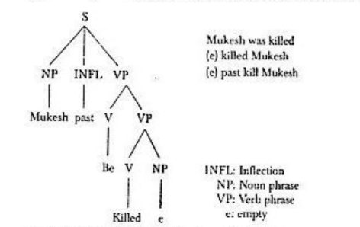
Government and Binding (GB)
(ii) In GB, the s-structure of the sentence - Mukesh was killed
Surface structure of sentence - Mukesh was killed

Slide 67
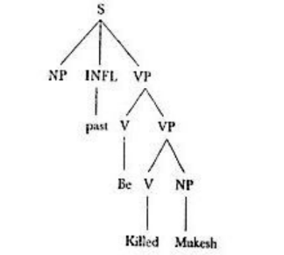
Government and Binding (GB)
(ii) In GB, the d-structure of the sentence - Mukesh was killed

Slide 68
Government and Binding (GB)
INFL - Inflection
a change in or addition to the form of a word that shows a change in the way it is used in sentences.
Example
If you add the plural inflection "-s" to "dog" you get "dogs".
By adding the inflection "-ed", you form the past tense of the verb.

Slide 69
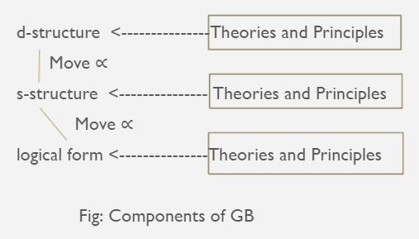
Components of GB
GB comprises a set of theories that map the structures from d-structure to s-structure and to logical form. Note: The phonetic form is not considered.
A general transformational rule called “Move ∝” is applied to d-structure level and s-structure level.
This can move the constituents at any place if it does not violate the constraints put by several theories and principles.
GB is represented as shown in fig.

Slide 70
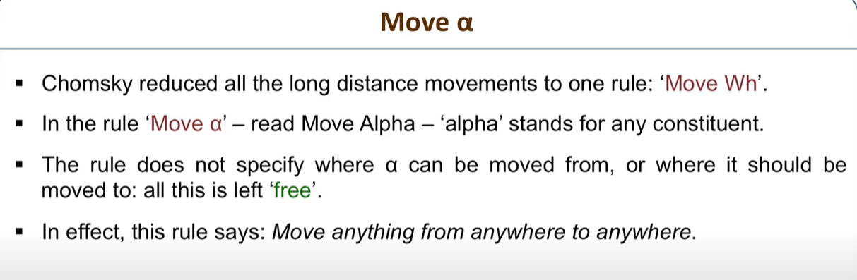
Components of GB

Slide 71
Government and Binding (GB)
GB consists of ‘a series of modules that contain constraints and principles’ applied at various levels of its representation and the transformation rule, Move ∝.
The modules include:
  X-bar theory
  Projection Principle
  θ -Theory
  θ - Criterion
  C-Command and Government
  Case Study or Theory
  Empty Category Principle (ECP)
  Binding Theory

Slide 72
General characteristics of GB
GB considers all three levels of representation, that is, d-, s- and LF as syntactic and LF is also related to meaning or semantic-interpretive mechanisms.
GB applies the same Move ∝ transformational rule to map d-levels to s-levels or s-levels to LF level.
LF level helps in quantifier scoping and also in handling various sentence constructions such as Passive or Interrogative Constructions.
Eg. Consider the sentence
Two countries are visited by most travelers
2 possible logical forms of the above sentence are:
LF1: [_{S} Two Countries are visited by [_{NP} most travelers]]
The interpretation is most travelers visit the same two countries (Ex: India and China)
LF2: Applying Move ∝
[_{NP} Most travellers_{i} ] [ _{S}two countries are visited by e_{i}] // e_{i} means empty element
When we move [most travelers] outside the scope of sentence, the interpretation can be that most travelers visit two countries, which may be different for different travelers.

Slide 73
General characteristics of GB
One of the important concepts in GB is that of constraints.
It is the part of the grammar which prohibits certain combinations and movements, otherwise Move ∝ can move anything to any possible position.
Thus, GB is basically the formulation of theories or principles which create constraints to disallow the construction of ill-formed sentences.
GB can specify that ‘a constituent cannot be moved from position X’, where X can have value X₁ in one language, X₂ in another language, and so on.

Slide 74
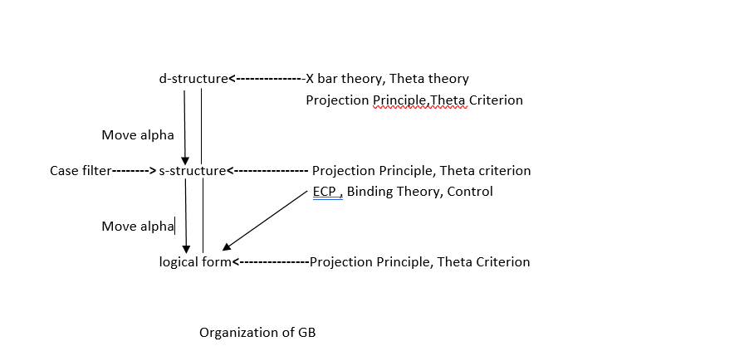
General characteristics of GB
The figure - components of GB showed the application of various theories and principles at three different levels of representations in GB. The above figure mentions the various theories and principles explicitly to understand the organization of GB.

Slide 75
GB- X BAR THEORY
The x bar theory is one of the central concepts in GB.
Instead of defining several phrase structures and the sentence structure with separate sets of rules, X bar theory defines them both as maximal projections of some head. Hence the entities defined become language independent.
Noun phrase (NP) is the maximal projection of Noun (N)
verb phrase (VP) is the maximal projection of Verb (V)
adjective phrase (AP) is the maximal projection of Adjective (A)
preposition phrase (PP) is the maximal projection of Preposition (P)
They can be represented as head X of their corresponding phrase (where X = {N, V, A, P}
Even the sentence structure S’ - which is projection of sentence can be regarded as the maximal projection of inflection (INFL).
GB envisages projection at 2 levels:
  1. The projection of head at semi phrase level, denoted by X bar
  2. The maximal projection at the phrase level, denoted by X double bar
For sentences -
  the first level projection is denoted as S
  and the second level maximal projection is defined as S’.

Slide 76
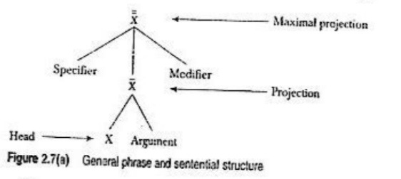
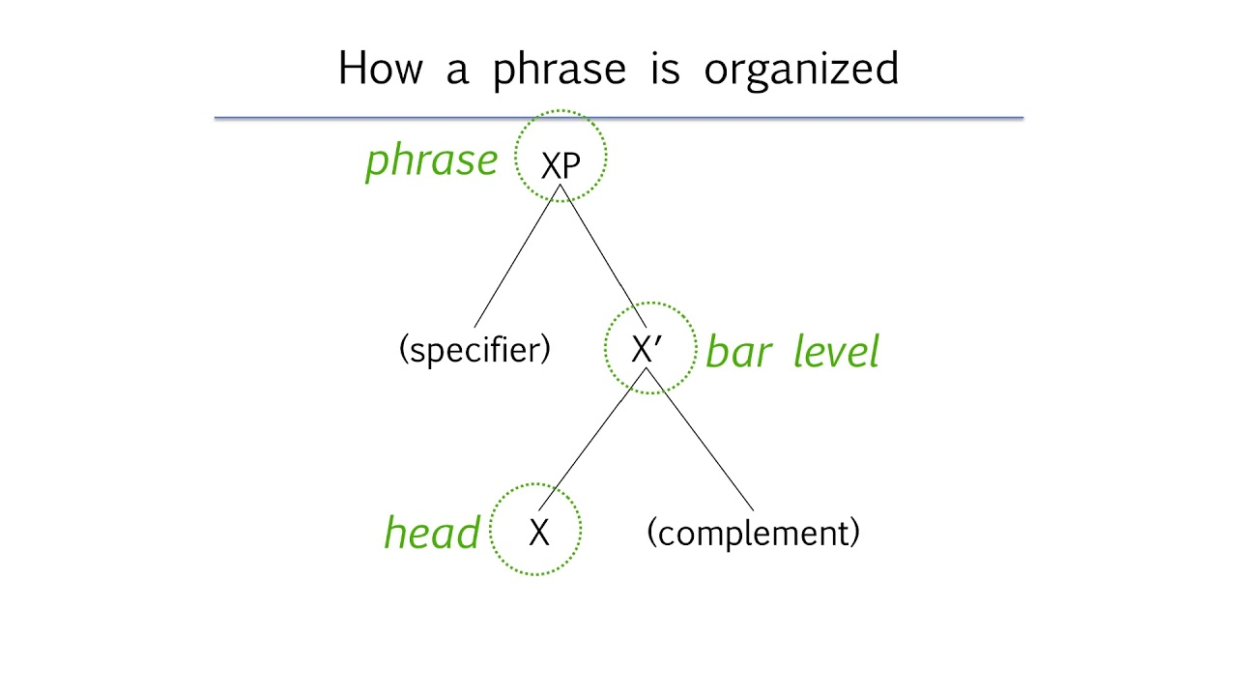
GB- X BAR THEORY
General Phrase and Sentential Structure:

Slide 77
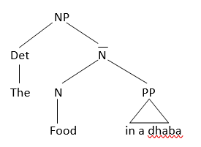
EXAMPLE
1.NP
The food in a dhaba.
[_{NP}[_{Det} the] [_{N}[_{N}food] [_{pp}in a dhaba]]
TRY!!!
The student in a college

Slide 78
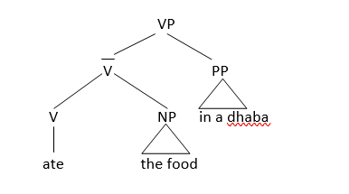
EXAMPLE
2. VP
ate the food in a dhaba
[ VP [ _{v} [ _{v} ate] [_{NP} the food ] ] [_{PP} in a dhaba ] ]
TRY!!!
Will do my home

Slide 79
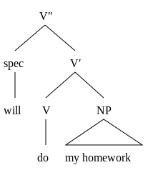
EXAMPLE
2. VP
will do my homework
[_{vp}[_{spec}will] [_{v’}[_{v} do] [_{np}my homework] ] ]

Slide 80
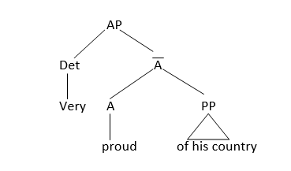
EXAMPLE
3.AP
Very proud of his country
[_{AP} [_{Deg} Very ] [ _{A} [_{A}proud] [_{PP} of his country] ] ]

Slide 81
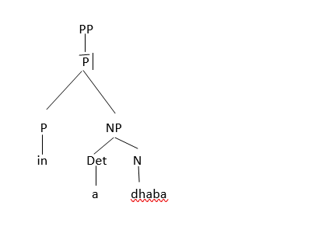
EXAMPLE
4.PP
in a dhaba
[_{PP} [ _{P} [ _{P}in] [_{NP} [ _{Det} a][_{N} dhaba ] ] ] ]
TRY!!!
from Hamilton

Slide 82
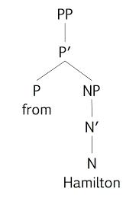
EXAMPLE
4.PP
from Hamilton
[_{PP} [ _{P} [ _{P}from] [_{NP} [_{N’}[_{N}Hamilton] ]] ] ]
TRY!!!
On the table

Slide 83
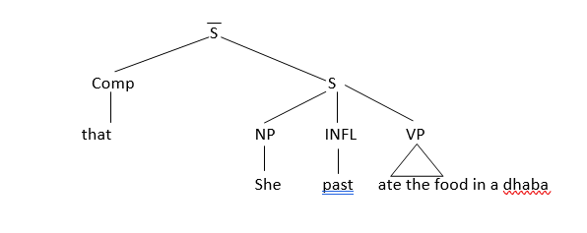
EXAMPLE
5.S
that she ate the food in a dhaba
[ _{S} [_{comp}that ][ _{S}[ _{Det} she ] [ _{INFL} past ] [ _{VP} ate the food in a dhaba ] ] ]
The sentence is considered to be the head of INFL and the projection of sentence is denoted by S bar, which has complementizer (COMP)
TRY!!!
That huge black and white extremely angry dog

Slide 84
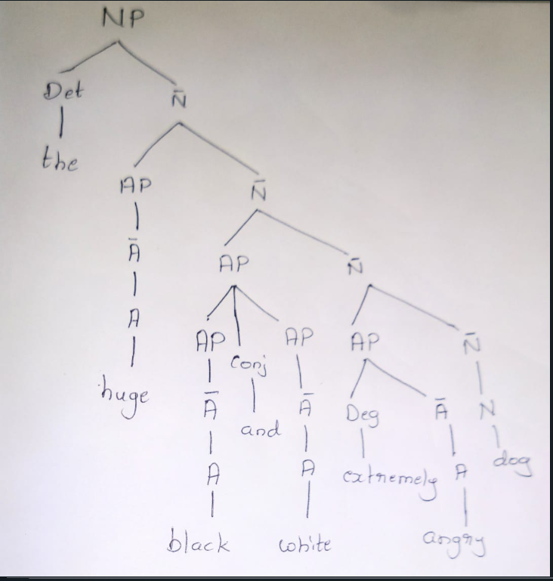
EXAMPLE
The huge black and white extremely angry dog

Slide 85
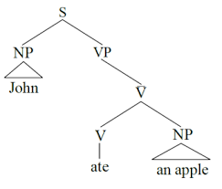
EXAMPLE
S: John ate an apple

Slide 86
GB
Sub- Categorization
GB places the burden of ascertaining well-formedness to sub-categorization frames of heads.
In principle, any Maximal projection can be argument of a head, but sub-categorization is used as a filter to permit various heads to select a certain subset of the range of maximal projection.
Ex: the verb ‘eat’ can subcategorize for NP, whereas the verb ‘sleep’ cannot. Hence ‘ate food’ is well formed but the sentence ‘slept the bed ‘ is not.
GB claims that defining phrase structures as head projections and sub-categorization helps ensure well-formed structures even at the sentence level.
Sub-categorization places a restriction on syntactic categories which the head can accept.

Slide 87
GB
Projection principle
Projection principle places a constraint on the three syntactic representations and their mapping from one to the other.
The projection principle states that representations at all syntactic levels (i.e., d-level, s-level, LF-level) are projection from the lexicon (head). Thus, lexical properties of categorical structure (sub-categorization) must be observed at each level.
Ex: Suppose the ‘object’ is not present at d-level, then another NP cannot take this position at s-level.
  Mukesh was killed OBJECT
Projection principle, in conjunction with the possibility of presence of empty category and other theories (Binding theory) ensures correct movement and well formed structure.

Slide 88
GB
Theta Theory (θ-theory) or the Theory of Thematic Relations
GB puts restriction on lexical heads through which it assigns certain roles to its arguments.
These roles are pre-assigned and cannot be violated at any syntactic level as per the projection principle.
These role assignments are called theta roles and are related to ‘semantic selection’.
Theta-role and theta-criterion
There are certain thematic roles from which a head can select. These are called theta-roles and they are mentioned in the lexicon.
Ex: The verb ‘eat’ can take arguments with θ-roles ‘(Agent-Theme)’.
Agent is a special type of role which can be assigned by a head to outside arguments (external arguments) whereas other roles are assigned within its domain (internal arguments).
For Eg., In ‘Mukesh ate food’ the verb ‘eat’ assigns the ‘Agent’ role to ‘Mukesh’ (outside VP) and ‘Theme’ (or ‘patient’) role to ‘food’ (within its domain).

Slide 89
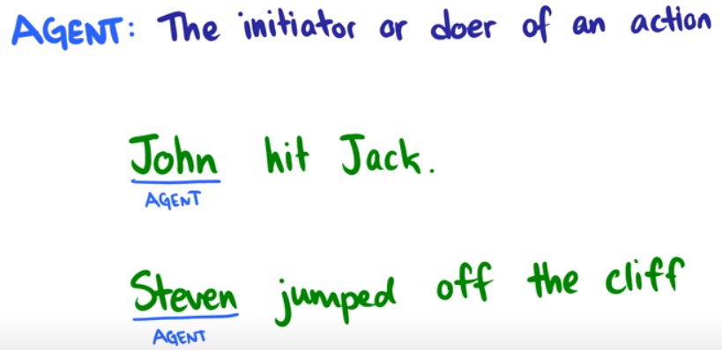
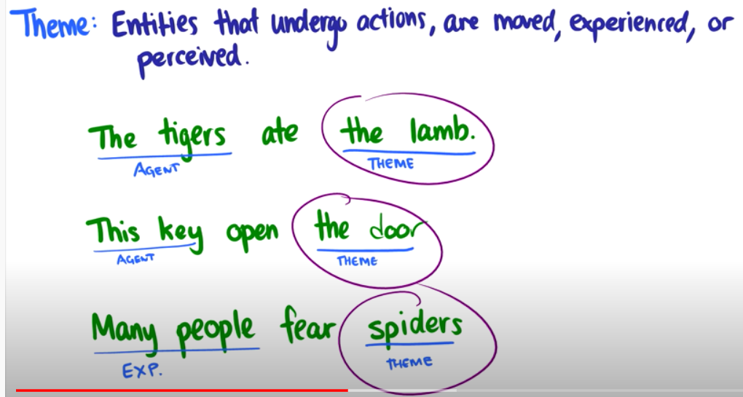
Examples for Agent and Theme
Notes:
other theta roles are 1. experiencer
2. goal
3. location

Slide 90
GB
As roles are assigned based on the syntactic positions of the arguments, there should be a match between the number of roles and number of arguments as depicted by θ-criterion.
Theta-criterion states that ‘each argument bears one and only one theta-role and each θ–role is assigned to one and only one argument’. Hence, each argument will have a unique θ-role and cannot be moved to a position where it may acquire another θ-role.
In GB, d-structure is conceived as ‘pure’ representation of arguments, hence, θ-roles are assigned at d-level only, whereas theta-criterion is applied at all the three level as shown in the figure

Slide 91
GB
C-command and government:
C-Command:
C-command defines the scope of maximal projection. It is a basic mechanism through which many constraints are defined on move α.
If any word or phrase (say ∝ or β) falls within the scope of and is determined by a maximal projection, then it is dominated by maximal projection.
Necessary and sufficient condition for C-command:
  If there are two structures α and β related in such a way that ‘every maximal projection dominating α dominates β’, we say that α C-commands β.
  The definition of C-command does not include all maximal projections dominating β, but only those dominating α.

Slide 92
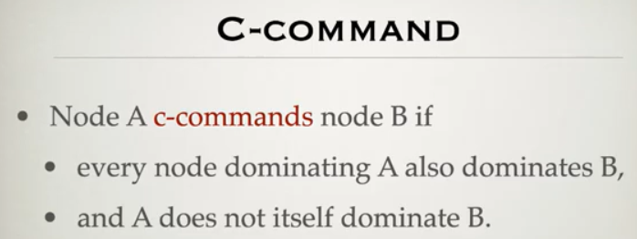
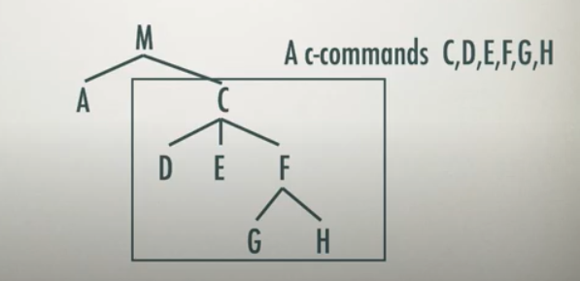
GB
C-command and government:
C-Command:

Slide 93
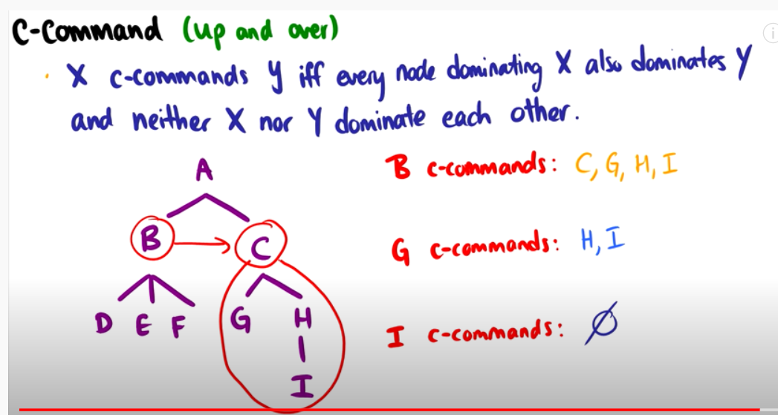
C-command Example

Slide 94
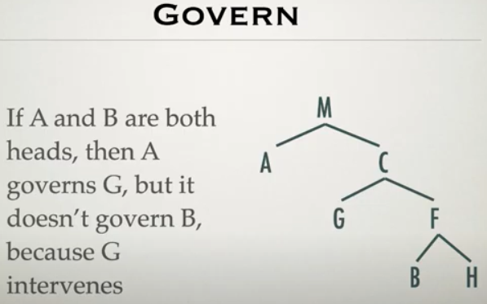
GB
Government:
Government is a special case of C-command.
  α governs β iff:
  α C-commands β
α is an X (head, eg: noun, verb, preposition, adjective and inflection), and every maximal projection dominating β dominates α.
No maximal projection can intervene between the governor and governee.

Slide 95
GB - Movement, Empty Category and Co-indexing
Movement:
move α is described as ‘move anything anywhere’, though it provides restrictions for valid movements.
The active to passive transformation is the result of NP movement.
Another well known movement is the wh-movement, where wh-phrase is moved as follows:
Ex: what did mukesh eat?
[Mukesh INFL eat what]
Notes:
Anaphore: a word or phrase that refers back to an earlier word or phrase
Anaphoric: a word or phrase that takes its reference from another word or phrase and especially from a preceding word or phrase
Pronominal means relating to pronouns or like a pronoun

Slide 96
GB - Movement, Empty Category and Co-indexing
Empty Category:
As per projection principal, lexical categories (noun, verb, preposition) must exist at all the three levels (d-level, s-level and LF level). This principle, when applied to some cases of movement leads to the existence of an abstract entity called empty category.
In GB, there are four types of empty categories, two being empty NP positions, called wh-trace and NP-trace and the remaining two being pronouns called small ‘pro’ and big ‘PRO’. This division is based on two properties – Anaphoric (+a and –a) and Pronominal (functioning as a pronoun) (+p or -p)
Wh trace -a, -p
NP trace +a, -p
Small pro -a, +p
Big pro +a, +p
Notes:
Anaphoric: a word or phrase that takes its reference from another word or phrase and especially from a preceding word or phrase
Pronominal means relating to pronouns or like a pronoun
"wh-word" (such as "who," "what," "where," "when," "why," etc.)

Slide 97
GB - Movement, Empty Category and Co-indexing
Empty Category:
Anaphoric:
Anaphoric (+a): An element that is labeled as "anaphoric" is one that refers back to or depends on a previous element in a sentence, often called the antecedent.
"John said he was tired." -> Here, "he" refers back to "John."
Non-Anaphoric (-a): An element labeled as "non-anaphoric" does not rely on a previous element in the sentence for its interpretation. It carries its meaning independently and does not require an antecedent to be understood.
"The sky is blue," Here, the word "sky" is a non-anaphoric noun because it doesn't depend on any previous element in the sentence.
Notes:
Anaphoric: a word or phrase that takes its reference from another word or phrase and especially from a preceding word or phrase
Pronominal means relating to pronouns or like a pronoun
"wh-word" (such as "who," "what," "where," "when," "why," etc.)

Slide 98
GB - Movement, Empty Category and Co-indexing
Empty Category:
Pronominal:
"-p" (Non-pronominal): When an element is labeled as "-p," it means that the element is non-pronominal. In other words, it is not functioning as a pronoun or does not have the characteristics of a pronoun. Non-pronominal elements are typically full nouns that do not stand in for or replace other elements in the sentence. Examples of non-pronominal elements:
"The cat" (a noun phrase)
"John's book" (a possessive noun phrase)
"+p" (Pronominal): When an element is labeled as "+p," it means that the element is pronominal. Pronominal elements function as pronouns, which are words or phrases that can replace nouns or noun phrases. Examples of pronominal elements:
"He" (replacing a specific person's name)
"It" (referring to a non-specific object)
"They" (representing a group of people or things)
Notes:
Anaphoric: a word or phrase that takes its reference from another word or phrase and especially from a preceding word or phrase
Pronominal means relating to pronouns or like a pronoun
"wh-word" (such as "who," "what," "where," "when," "why," etc.)

Slide 99
GB - Movement, Empty Category and Co-indexing
Co-indexing:
Co-indexing is the indexing of the subject NP and AGR (agreement) at d-structure which are preserved by move α operation at s-structure.
Example:
  James hit himself - James and himself are co-indexed.
  James hit himself for hurting her. - her is not co-indexed.
When an NP-movement takes place, a trace of the movement is created by having an indexed empty category (e_{i}) from the position at which the movement began to the corresponding indexed NP, i.e. NP_{i}

Slide 100
GB
Binding theory:
Binding is defined by Sells (1985) as follows
α binds β iff
α C-commands β and
α and β are co-indexed
Example:
[e_{i} INFL kill Mukesh]
[Mukesh_{i} was killed (by e_{i})]
Mukesh was killed.
Empty clause (e_{i}) and Mukesh (NP_{i}) are bound. This theory gives relationship between NPs.
Binding Theory: https://www.youtube.com/watch?v=BiSX3Hi5zaM&t=52s

Slide 101
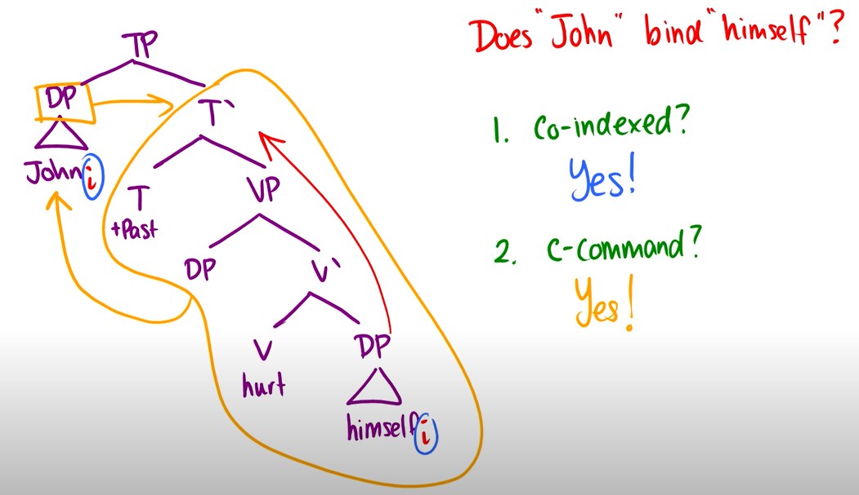

GB
Binding Theory Example

Slide 102
GB
Binding theory:
Binding theory is given as -
An anaphor (+a) is bound in its governing category.
A pronominal (+p) is free in its governing category.
An R-expression (-a, -p) is free.
Example:
A: Mukesh_{i} knows himself_{i}
B: Mukesh_{i} believes that Amrita knows him_{i}
C: Mukesh believes that Amrita_{j} knows Nupur_{k}
Similar rules apply on empty categories also:
NP-trace: +a, -p: Mukesh_{i} was killed e_{i}
wh-trace: -a, -p: Who_{i} does he_{i} like e_{i}
Binding Principles A, B and C: https://www.youtube.com/watch?v=U6McDsR9YeA&t=50s

Slide 103
GB
Empty category principle (ECP)
‘Proper government’
α properly governs β iff
α governs β and α is lexical (i.e, N, V, A or P) or
α locally A binds β.
Bounding and control theory:
In English, the long distance movement for complement clause can be explained by bounding theory if NP and S are taken to be bounding nodes.
The theory says that the application of move α may not cross more than one bounding node.
The theory of control involves syntax, semantics and pragmatics.

Slide 104
GB
Case Theory and Case Filter
Case Theory:
In GB, case theory deals with the distribution of NPs and mentions that each NP must be assigned a case.
In English, we have Nominative, Objective, Genitive, etc., cases which are assigned to NPs at particular positions.
Case Filter:
An NP is ungrammatical if it has phonetic content or if it is an argument and is not case marked.
Case filters restrict the movement of NP at a position which has no case assignment.

Slide 105
LEXICAL FUNCTIONAL GRAMMAR
Lexical functional grammar (LFG) is a constraint-based grammar framework in theoretical linguistics.
It posts two separate levels of syntactic structure
A phrase structure grammar representation of word order and constituency,
A representation of grammatical functions such as subject and object, similar to dependency grammar.

Slide 106
LEXICAL FUNCTIONAL GRAMMAR
The term ‘lexical functional’ is composed of two parts:
The lexical part
- is derived from the fact that the lexical rules can be formulated to help define the structure of a sentence
The functional part
is derived from grammatical functions such as subject and object or roles played by various arguments in a sentence.
LFG represents sentences at two syntactic levels –
Constituent structure (c-structure)
Functional structure (f-structure).

Slide 107
LEXICAL FUNCTIONAL GRAMMAR
C-Structure and F-structure in LFG
C-Structure
The c-structure is derived from the phrase and sentence structure syntax.
C-Structure is used for encoding linear order constituency and hierarchical relations.
F-structure
f-structure is a set of attribute-value pairs.
f-structure encodes the information obtained from phrase and sentence structure rules and functional specifications.
As the grammatical functional role cannot be derived directly from phrase and sentence structure, functional specification are annotated as the nodes of c-structure, which when applied on sentences, results in f-structure.
Ref: https://www.youtube.com/watch?v=EoCLhS_0cmE

Slide 108
LEXICAL FUNCTIONAL GRAMMAR
Example: She saw stars in the sky
CFG rules to handle this sentence are:
S -> NP VP
VP -> V {NP} {NP} PP* {S’}
PP -> P NP
NP -> Det N {PP}
S’ -> Comp S
where
S: sentence; V: verb;
P: preposition, N: noun;
S’: clause; Comp: complement
{} optional;
*: Phrase can appear any number of times including blank.

Slide 109
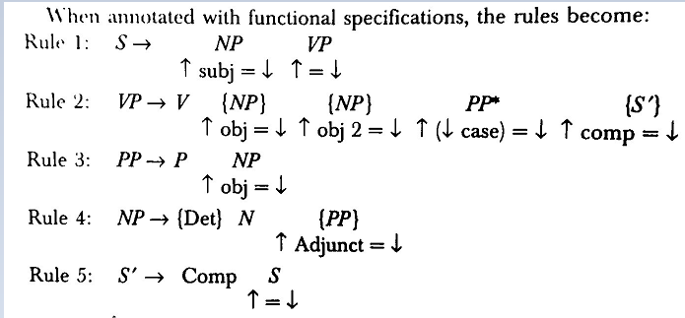
LEXICAL FUNCTIONAL GRAMMAR

Slide 110
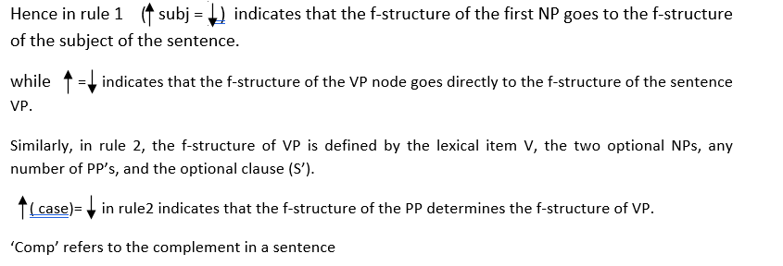
LEXICAL FUNCTIONAL GRAMMAR
The up arrow refers to the f-structure of the mother node that is on the left hand side of the rule.
The down arrow refers to the f-structure of the node under which it is denoted.

Slide 111
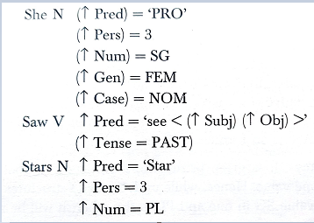
LEXICAL FUNCTIONAL GRAMMAR
Lexical entries of the words in the sentence - She saw Stars

Slide 112
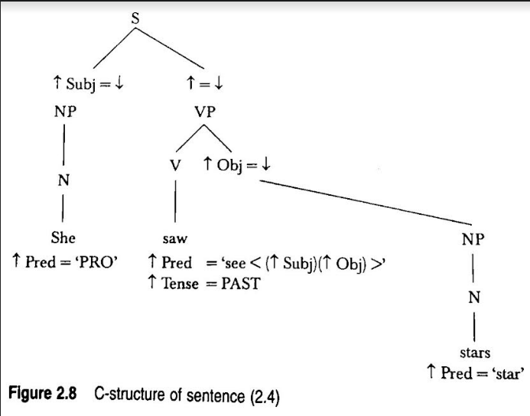
LEXICAL FUNCTIONAL GRAMMAR
C-Structure of sentence - She saw stars

Slide 113
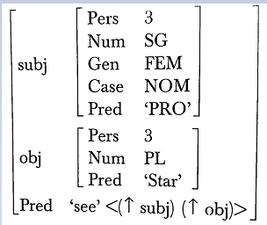
LEXICAL FUNCTIONAL GRAMMAR
Finally, the f-structure is the set of attribute-value pairs, represented as
F-Structure of sentence - She saw start

Slide 114
LEXICAL FUNCTIONAL GRAMMAR
LFG imposes three conditions on f-structure:
Consistency: In a given f-structure, a particular attribute may have at most one value. Hence, while unifying two f-structures if the attribute num has value SG in one and PL in the other, it will be rejected.
Completeness: A function is called governable if it appears within the pred value of some lexical form.
ex: sub, obj and obj2. Adjunct is not a governable function.
Coherence: Coherence maps the completeness property in the reverse direction. It requires that all governable functions of an f-structure, and all its subsidiary f-structures must be governed by their respective predicates.
Example: In the f-structure of a sentence, an object cannot be taken if its verb does not allow that object. Thus, it will reject the sentence, “I laughed a book”
Reference: https://www.youtube.com/watch?v=VMkCdkkyYsU&list=PLLBpKrZiIqZ97ZhbbwSLV6nDZXVdsPbCy&index=1&t=1s

Slide 115
LEXICAL FUNCTIONAL GRAMMAR
In LFG, the verb is converted to the participle form, but the sub-categorization is changed directly ex:
Action : Tara ate the food
Passive: The food was eaten by Tara.
Active: Pred=’eat<( subj)( obj)>
Passive: Pred=’eat<( oblag)( subj)>
Similar rules are also applicable to the process of causativization.
Causativization
Laugh laughed( Laugh cause past made to laugh)
Ex: Active : Tarraa hansii
Tara laughed
Causative : Monika ne tara ko hansaaya.
Monika subj Tara obj laugh cause-past.
Monika made tara to laugh.
Active : Pred =’Laugh < subj >’
Causative: Pred = ‘Cause<( subj)( obj)(comp)>’
.

Slide 116
LEXICAL FUNCTIONAL GRAMMAR
Long distance Dependencies and co-ordination
In GB, when a category is moved, it creates an empty category.
In LFG, unbounded movement and co-ordination is handled by the functional identity and by correlation with the corresponding f-structure.

Slide 117
PANINIAN FRAMEWORK
Paninian grammar (PG) was written by Panini in 500 BC in Sanskrit. The original text is titled Asthadhyayi.
PG framework can be used for other Indian languages and even for some Asian languages.
Unlike English, Asian languages are SOV (Subject-Object-Verb) ordered and inflectionally rich. The inflections provide important syntactic and semantic for language analysis and understanding.
The classical Paninian Grammar facilitates the task of obtaining the semantics through syntactical framework.
In PG, an extensive and perfect interpretation of Phonology, Morphology, Syntax and Semantics is available.
For more information on PG
https://www.studocu.com/in/document/mahatma-gandhi-university/english-i/karaka-theory-in-literature/23621721

Slide 118
PANINIAN FRAMEWORK
Important features of Indian languages:
Indian languages have traditionally used oral communication for knowledge propagation there by making Indian languages morphologically rich language.
Indian languages are word-order free languages. The have the flexibility to allow word groups representing subject, object, and verb to occur in any order.
Eg: माँ बच्चे को खाना देती है - Mother gives food to the child.
बच्चे को माँ खाना देती है - Mother gives food to the child.
The auxiliary verb follows the main verb. In Hindi, they remain as separate words, but in south Indian languages they combine with the main verb.
Eg: खा रहा है - eating
करता रहा है - has been doing
Some verbs combine with other verbs to change the aspect and modality of the verbs
Eg: उसने खाना खाया - He ate food
उसने खाना खा लिया - He ate food (completed the action)
वाह चला - He moved
वाह चल दिया - He moved

Slide 119
PANINIAN FRAMEWORK
Important features of Indian languages:
The nouns are followed by post-positions instead of prepositions.
रेखा के पिता Rekha’s father
उस के पिता His/Her father
All features are not same among Indian languages. verb groups are differently in Indo-Aryan and Dravidian languages.
Sanskrit is very different from the other Indian languages. It has five tenses and three number and only one time aspect in each tense. He goes and he is going is same in sanskrit.
Hindi is unique. It has no neuter gender. All nouns are categorized as feminine or masculine and verb form must have a gender agreement with the subject
ताला खो गया The lock was lost
चाभी खो गयी The key was lost

Slide 120
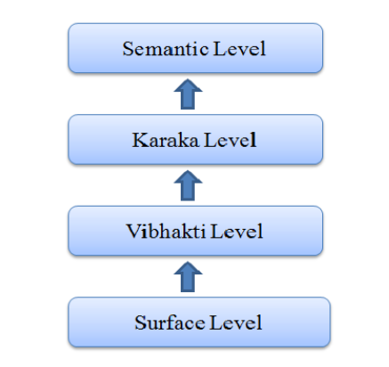
PANINIAN FRAMEWORK
Layered representation in paninian grammar:
Paninian Grammar (PG) framework is said to be syntactico–semantic that is one can go from surface layer to deep semantics by passing through immediate layers.
PG works on various levels of language analysis to achieve the meaning of the sentence from hearer’s perspective. To achieve the desired meaning, the grammar analysis is divided itself internally into the various levels as shown in the figure below.
fig: Layered Representation in PG

Slide 121
PANINIAN FRAMEWORK
Semantic Level:
Represents the speaker’s actual intention, that is, his real thought for the sentence.
Surface Level:
Surface level is the actual string or the sentence. It captures the written or the spoken sentences as it is.
Vibhakti Level:
Vibhakti is the word suffix, which helps to find out the participants, gender as well as the form of the word.
Vibhakti level is purely syntactic. At this level, the case endings are used to form the local groups of the words. At Vibhakti level, a noun is formed containing a noun, which contains the instances of noun or pronoun etc.
Vibhakti for verbs includes the verb form and the auxiliary verbs.
Vibhakti gives Tense Aspect Modality details of the word which is popularly known as TAM.
Karaka Level:
At the Karaka level, the relation of the participant noun, in the action, to verb is determined.
Karaka relations are Syntactico-semantic.
These relations are established in between the verb and other constituent nouns that are present in the sentences. Through, these relations, the Karakas try to capture the information from the semantics of the texts.
Karaka level processes the semantics of the language but represents it at the syntactic level. Hence it acts as a bridge between semantic and syntactic analysis of a language.

Slide 122
PANINIAN FRAMEWORK
Karaka Theory:
The etymological meaning of the word Karaka is ‘one who does something’, i.e. one who performs an action.
The Karaka and the Kriya, i.e. the cases and verb are bounded with the sense of mutual requirement.
The one who performs an action, accepts an action, or otherwise helps to perform an action is known as a Karaka.
There is a mutual expectancy in between the action i.e. Kriya and the adjuncts i.e. Karaka.
The presence of one calls for the existence of the other. In other words Kirya and Karaka are mutually exclusive.

Slide 123
PANINIAN FRAMEWORK
Karaka Theory:
The Karakas are derived by analyzing the direct and continuous or mutual relation between the verb and the nominal.
Various Karakas are:
Karta - subject
Karma - object
Karana - instrument
Sampradhana - beneficiary
Apadana - separation
Adhara or Adhikarana - locus
Sambandh - relation
Tadarthya - purpose
The Karta, Karma and Karana are considered as the foremost Karakas while
Sampradana, Apadana and Adhikarana Karakas are known as the influenced Karakas.

Slide 124
PANINIAN FRAMEWORK
Karta Karaka:
The Karta Karaka is the premier one according to action and it is used to perform an action independently of its own. An action indicated in a sentence is entirely dependent upon the Karta-Karaka. Activity either resides in or rises from the Karta only.
Eg. Tiger killed the goat
Tiger - karta.
Karma Karaka:
Karma is the Aashraya (locus) of the result. The most desirable nominative by the Karta Karaka is the Karma Karaka. When the Karta carries out any activity, the result of that activity rests in the Karma. As the Karma (object) is the basis of outcome of the primary action, it is one of the important prominent Karaka.
Eg. Tiger killed the goat.
goat is karma.

Slide 125
PANINIAN FRAMEWORK
Karana Karaka:
Karaka which helps in carrying out the Kriya is known as Karana Karaka. Karana Karaka helps in attaining the desired result ascertained by the Kriya. Karana is the most important tool by means of which the action is achieved. Karana is the only direct participant in the action. Karta and Karma also are directly dependent on the Karana for performing the action. When the Karana Karaka executes its auxiliary actions then only the main action is executed by the Karta Karaka. This is why the Karana is considered as the efficient mean in action accomplishment.
Example:
The man cut the wood with an axe
Ram cuts the apple with knife.
karana - axe and knife

Slide 126
PANINIAN FRAMEWORK
Sampradhana Karaka:
The word Sampradana can be interpreted as ‘He to whom something is given properly’. Sampradana Karaka receives or gets benefited from the action. It can also be said that, the person/object for which the Karma is intentional, is known as Sampradana. In this regard, the Sampradana is the final destination of the action.
Example:
Dipti gave chocolates to Shambhavi
Shambhavi is sampradhana.
Ram gave me a book.
me is sampradhana
He gave flowers for Shambhavi
Shambhavi is sampradhana

Slide 127
PANINIAN FRAMEWORK
Apadana Karaka:
About Apadana Karaka Panini stated that, as when separation is affected by a verbal action, the point of separation is called Apadana. During the execution of the action whenever the task of separation from a certain entity is executed then whatever remains unmoved or constant is known as Apadana. Thus, an Apadana denotes the starting point of an action of separation. The entity from which something gets separated or is separated out is known as Apadana.
Example:
Shambhavi tore the page from the book with a scissor.
From the book is apadana

Slide 128
PANINIAN FRAMEWORK
Adhikarana Karaka:
‘Adhikarana’ is the place or thing, which is the location of the action existing in the agent or the object. Adhikarana is assigned to the locus of the action i.e. Kriya. Adhikarana may indicate the place at which the Kriya (the action) is taking place or the time at which the Kriya is carried out. Any action i.e. the Kriya is either bounded by space (place) or by time.
Example1:
‘Yesterday Shambhavi hit the dog with the stick in front of the shop.’
The Karaka annotation of the above sentence can be given as:
hit : verb (root)
Yesterday : Kala-Adhikarana (time)
Shambhavi : Agent i.e. Karta
Dog : Karma
Stick : Karana
Shop : Desh-Adhikarana (location i.e. Place)

Slide 129
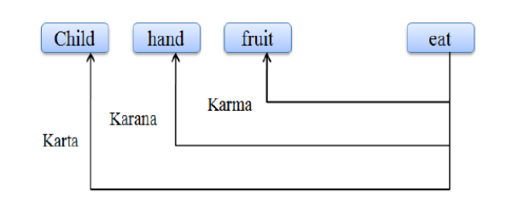
PANINIAN FRAMEWORK
Example 2:
‘The child eats the fruits with the hands’.

Slide 130
PANINIAN FRAMEWORK
Example 3:
Identify different karaka’s in the following Hindi sentence - “Maan bachchi ko angan mein haath se roti khilaathi hei”
Karaka role:
khilaathi hei - Verb (root)
Maan - Karta
roti - Karma
haath - Karana
bachchi - Sampradhana
angan mein - Adhikaran

Slide 131
PANINIAN FRAMEWORK
Issues in Paninian grammar:
Computational implementation of PG
Computation implementation of PG is a multilayered implementation. The rules are arranged in multiple layers such that each layer consists of rules which are in exception to rules in the higher layer.
Adaptation of PG to Indian and other similar languages.
As the system of rules is different in different languages, the framework requires adaptations to tackle various applications in various languages.
Difficulty arises when mapping between the vibhakti (case markers and post-positions) and the semantic relation (with respect to verb). Two different vibhakti can represent the same relation, or the same vibhakti can represent different relations in different contexts.

Slide 132
Statistical Language Model
Statistical Language Modelling is the development of probabilistic models that can predict the next word in the sequence of words given the words that precedes it.
A number of statistical language models have been proposed in literature. The dominant approach in modelling is the n-gram model.

Slide 133



Conditional Probability and Chain Rule
Conditional probability refers to the probability of one event occurring given that another event has already occurred. It is expressed as follows for events A and B.
From the above equation, the following equation can be derived.
Generalizing this for n events, we can easily infer the following holds for event A₁, A₂, … , Aₙ, Inductively.

Slide 134


Probability for Sentence
The probability of a sentence S composed of the word w₁, w₂, … ,wₙ can be expressed as follows:
P(A little boy smiles)=P(A)×P(little | A)×P(boy ∣ A little)×P(smiles | A little boy)
Count-Based Approach
calculate the probability of the next word based on counts (the number of times the sequence appears in the corpus) when given the previous words.
the size of the corpus is finite in a count-based approach, it becomes infeasible to train the model for all situations in a language, making it impossible to accurately model the language.

Slide 135

Sparsity Problem
To address this issue of not having enough observed data to accurately model language, the n-gram model was proposed. N-gram models tackle the sparsity problem by considering smaller contextual units (n-grams) instead of whole sequences, which allows for more manageable and efficient training on limited data.
Markov Chain
A Markov Chain or Markov Process is a discrete probability process that satisfies the Markov Property. The core of the Markov Property is that, given the current state and past states, the future state is determined solely by the current state and is independent of the past states.

Slide 136
N-gram Language Model
An n-gram language model still uses a statistical count-based approach, but it assumes the Markov Property, considering only a subset of words instead of all previously occurred words. For example, given the sequence ‘A little boy’, it approximates P(smiles | A little boy) ≈ P(smiles | boy), increasing the likelihood of counting that word sequence in the corpus.
N-gram means a sequence of n consecutive words, and in the n-gram Language Model, a sequence of n words in a corpus is considered as one token. In this case, if n=1, it is called unigram, if n=2, it is called bigram, and if n=3, it is called trigram. If n≥4, the number is directly attached to the front of gram to name it.

Slide 137
Implementation of N-gram Language Model
import nltk
from nltk.corpus import brown
from collections import Counter
def ngram(tokens, n):
return list(zip(*[tokens[i:] for i in range(n)]))
corpus = brown.sents()
tokens = [token.lower() for sent in corpus for token in sent]
unigram_counts = Counter(ngram(tokens, 1))
bigram_counts = Counter(ngram(tokens, 2))
total_count = len(tokens)
unigram_probs = {unigram: count/total_count for unigram, count in unigram_counts.items()}
bigram_probs = {bigram: count/unigram_counts[bigram[:1]] for bigram, count in bigram_counts.items()}

Slide 138
def sentence_prob(sentence):
tokens = nltk.word_tokenize(sentence.lower())
bigrams = ngram(tokens, 2)
prob = 1
for bigram in bigrams:
if bigram in bigram_probs:
prob *= bigram_probs[bigram]
else:
prob *= unigram_probs[(bigram[1],)]
return prob

Slide 139

Think about the sentence ‘An adorable little boy is spreading smiles’. Given ‘An adorable little boy is spreading’, we want to predict the next word w. Using 4-gram, we can predict the word w using the following probability:

Slide 140
Statistical Language Model - n-gram Model
The goal of a statistical language model is to estimate the probability of a sentence.
This is achieved by decomposing the sentence probability into a product of conditional probabilities using the chain rule as follows:
P(s) = P(w₁, w₂, w₃,..., w_{n})
= P(w1) P(w2/w1) P(w3/w1 w2) P(w4/w1 w2 w3) … P(wn/ w1 w2 … wn-1)
_{n}
= 𝚷 P(w_{i}/h_{i}) where h_{i} is history of word w_{i} defined as w₁, w₂,...w_{i-1}
^{i=1}

Slide 141
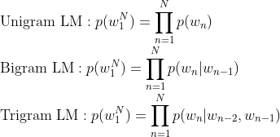
Statistical Language Model - n-gram Model
To calculate sentence probability, we need to calculate the probability of a word given the sequence of words preceding it.
The n gram model simplifies the task by approximating the probability of a word given all the previous words by the conditional probability given previous n-1 words only.
n-gram model calculates P(w_{i}/h_{i}) by modelling language as Morkov model of order n-1, that is, by looking at previous n-1 words only.
A model that limits the history to the previous one word only is termed as bi-gram (n=1) model.
A model that conditions the probability of word to the previous two words is called tri-gram (n=3) model.

Slide 142
Statistical Language Model - n-gram Model
A special word (pseudo word) <s> is introduced to mark the beginning of the sentence in bi-gram estimation.
The probability of the first word in a sentence is conditioned on <s>.
Similarly, in tri-gram estimation, two pseudo-words <s1> and <s2> are introduced.

Slide 143
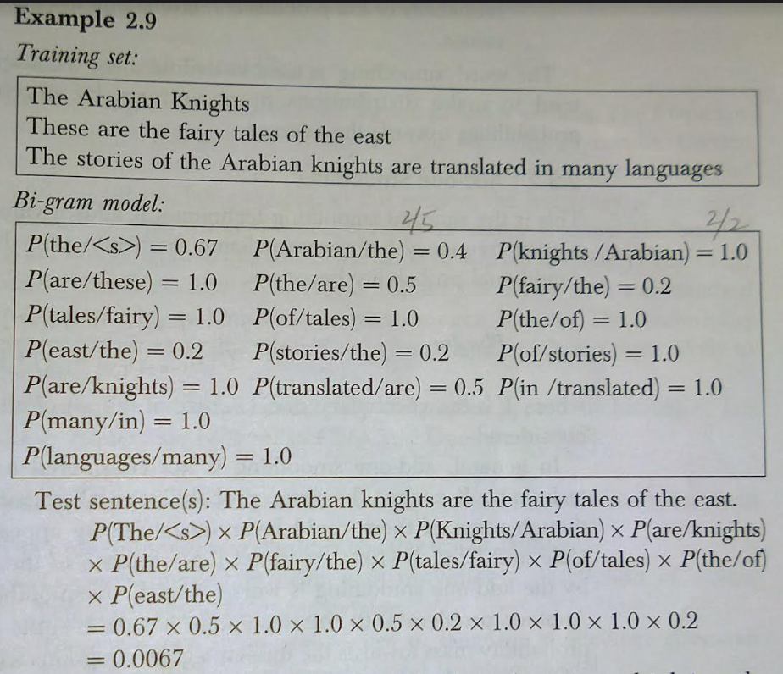
Statistical Language Model - n-gram Model

Slide 144
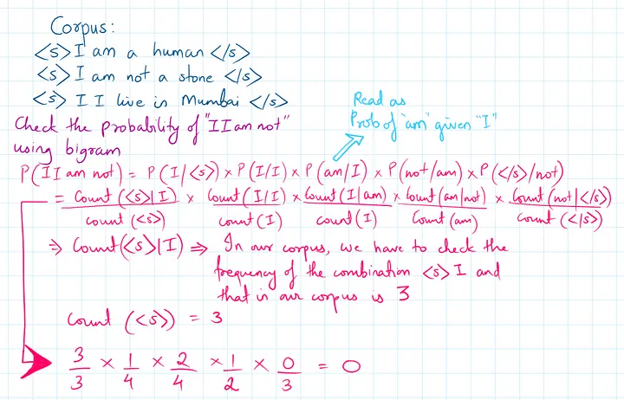
https://medium.com/@abhishekjainindore24/n-grams-in-nlp-a7c05c1aff12

Slide 145
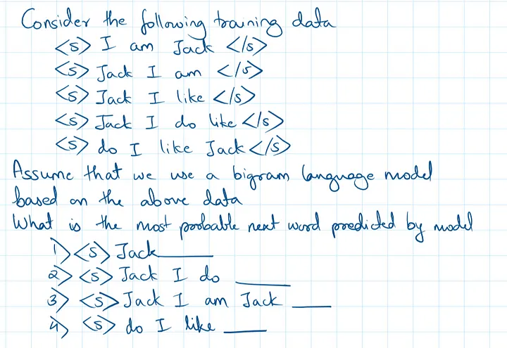

Slide 146


Slide 147


